Slide 1
Math 5365:Computer Literacy & Programming; Mathematical Foundations of Data Science with Applications on the MAPLE and MATLAB Platforms
INTRODUCTION

Slide 2
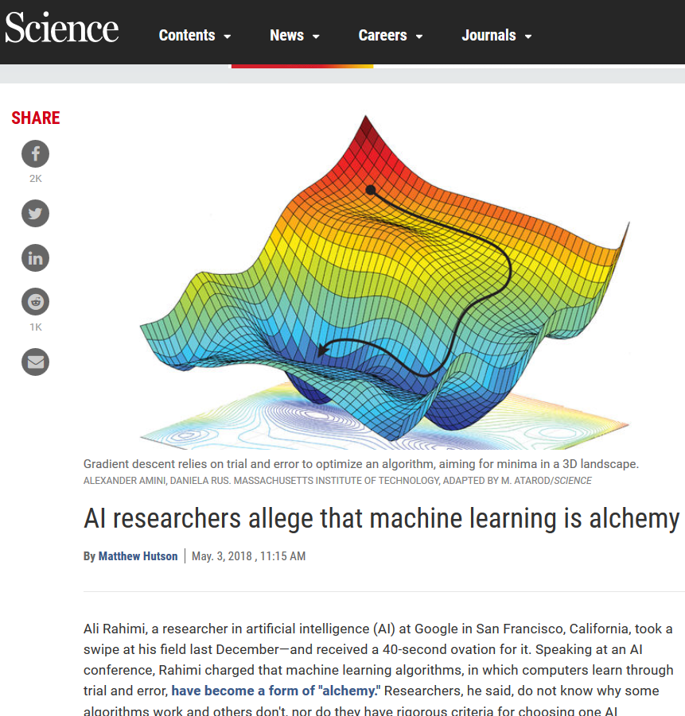
DS is a collection of practices, wisdoms, know-how-s

Slide 3
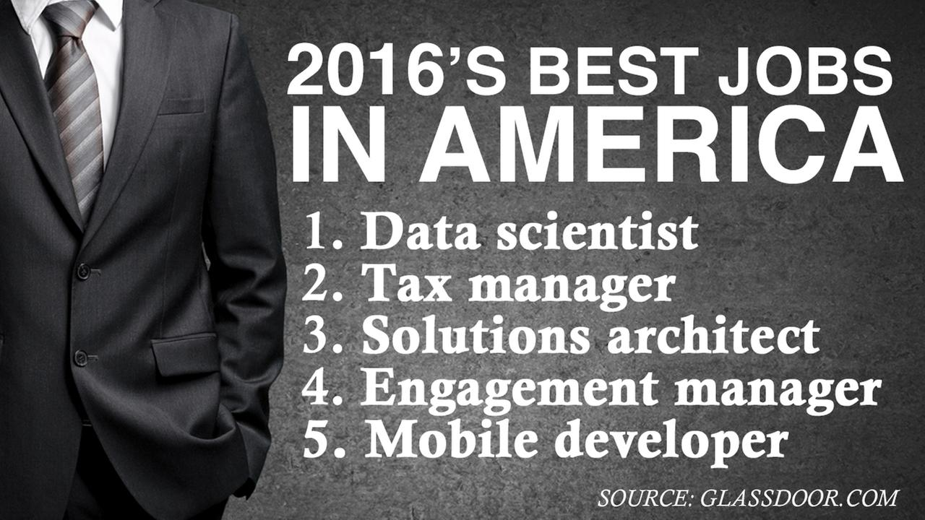

Slide 4
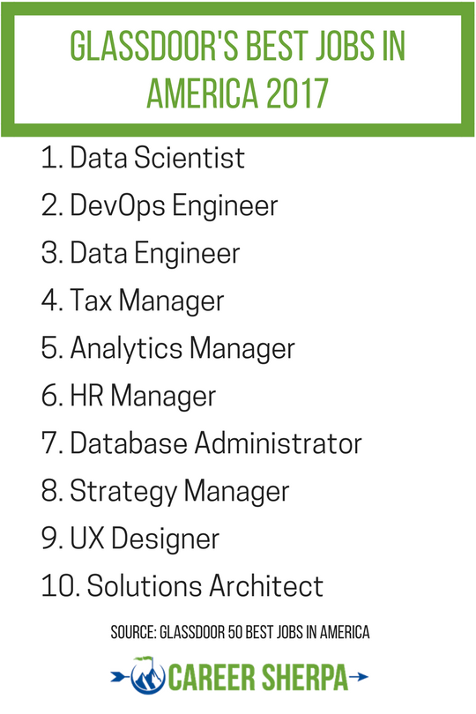
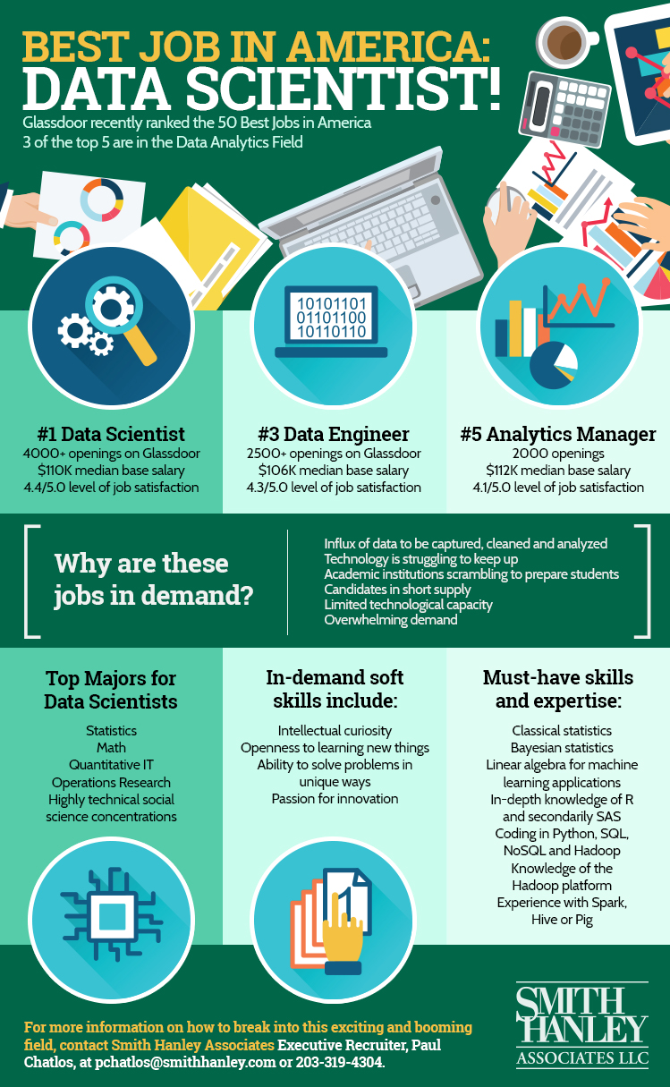

Slide 5
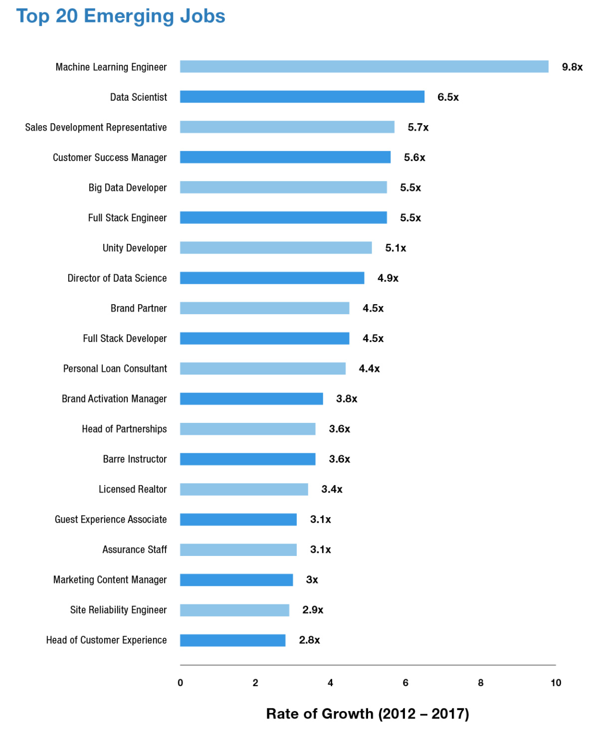
The 20 Fastest-Growing Jobs in the US (2017)
The rise of artificial intelligence are driving demand: Machine learning engineer, data scientist, and big data engineer are just a few that are top of mind for companies.
Hiring for outstanding soft skills is a high priority: Many of the roles on the list are customer-facing that underscore the importance of being able to screen candidates for soft skills.
Some roles are so new, that the current talent pool is minimal: A few of the jobs on this list didn’t even exist five years ago, they were niche with very few professionals in these roles

Slide 6
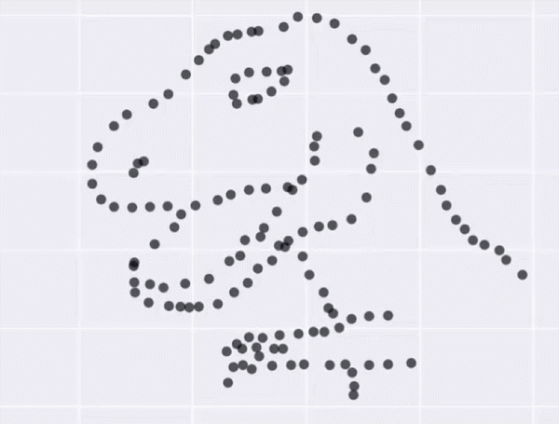
What are data scientists paid for?

Slide 7
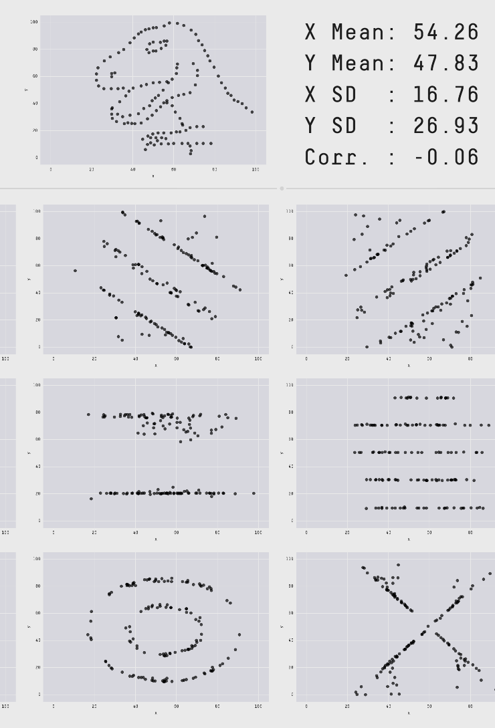
What are data scientists paid for?
The standard statistical methods do not allow for discerning patterns;
Clustering, pattern recognition, learning methods should be used for highly correlated, multivariate, and heterogeneous data arrays

Slide 8

Welcome to Apache™ Hadoop®!
What Is Apache Hadoop?
The Apache™ Hadoop® project develops open-source software for reliable, scalable, distributed computing.
The Apache Hadoop software library is a framework that allows for the distributed processing of large data sets across clusters of computers using simple programming models. It is designed to scale up from single servers to thousands of machines, each offering local computation and storage. Rather than rely on hardware to deliver high-availability, the library itself is designed to detect and handle failures at the application layer, so delivering a highly-available service on top of a cluster of computers, each of which may be prone to failures.
The project includes these modules:
Hadoop Common: The common utilities that support the other Hadoop modules.
Hadoop Distributed File System (HDFS™): A distributed file system that provides high-throughput access to application data.
Hadoop YARN: A framework for job scheduling and cluster resource management.
Hadoop MapReduce: A YARN-based system for parallel processing of large data sets.
Other Hadoop-related projects at Apache include:
Ambari™: A web-based tool for provisioning, managing, and monitoring Apache Hadoop clusters which includes support for Hadoop HDFS, Hadoop MapReduce, Hive, HCatalog, HBase, ZooKeeper, Oozie, Pig and Sqoop. Ambari also provides a dashboard for viewing cluster health such as heatmaps and ability to view MapReduce, Pig and Hive applications visually alongwith features to diagnose their performance characteristics in a user-friendly manner.
Avro™: A data serialization system.
Cassandra™: A scalable multi-master database with no single points of failure.
Chukwa™: A data collection system for managing large distributed systems.
HBase™: A scalable, distributed database that supports structured data storage for large tables.
Hive™: A data warehouse infrastructure that provides data summarization and ad hoc querying.
Mahout™: A Scalable machine learning and data mining library.
Pig™: A high-level data-flow language and execution framework for parallel computation.
Spark™: A fast and general compute engine for Hadoop data. Spark provides a simple and expressive programming model that supports a wide range of applications, including ETL, machine learning, stream processing, and graph computation.
Tez™: A generalized data-flow programming framework, built on Hadoop YARN, which provides a powerful and flexible engine to execute an arbitrary DAG of tasks to process data for both batch and interactive use-cases. Tez is being adopted by Hive™, Pig™ and other frameworks in the Hadoop ecosystem, and also by other commercial software (e.g. ETL tools), to replace Hadoop™ MapReduce as the underlying execution engine.
ZooKeeper™: A high-performance coordination service for distributed applications.

Slide 9

The most important questions of data science:
Whether the data is worth learning? does it contain the valuable information?
How an elementary patch of information is related to the whole? “fake news” (irrelevant to the context)
Welcome to Apache™ Hadoop®!
What Is Apache Hadoop?
The Apache™ Hadoop® project develops open-source software for reliable, scalable, distributed computing.
The Apache Hadoop software library is a framework that allows for the distributed processing of large data sets across clusters of computers using simple programming models. It is designed to scale up from single servers to thousands of machines, each offering local computation and storage. Rather than rely on hardware to deliver high-availability, the library itself is designed to detect and handle failures at the application layer, so delivering a highly-available service on top of a cluster of computers, each of which may be prone to failures.
The project includes these modules:
Hadoop Common: The common utilities that support the other Hadoop modules.
Hadoop Distributed File System (HDFS™): A distributed file system that provides high-throughput access to application data.
Hadoop YARN: A framework for job scheduling and cluster resource management.
Hadoop MapReduce: A YARN-based system for parallel processing of large data sets.
Other Hadoop-related projects at Apache include:
Ambari™: A web-based tool for provisioning, managing, and monitoring Apache Hadoop clusters which includes support for Hadoop HDFS, Hadoop MapReduce, Hive, HCatalog, HBase, ZooKeeper, Oozie, Pig and Sqoop. Ambari also provides a dashboard for viewing cluster health such as heatmaps and ability to view MapReduce, Pig and Hive applications visually alongwith features to diagnose their performance characteristics in a user-friendly manner.
Avro™: A data serialization system.
Cassandra™: A scalable multi-master database with no single points of failure.
Chukwa™: A data collection system for managing large distributed systems.
HBase™: A scalable, distributed database that supports structured data storage for large tables.
Hive™: A data warehouse infrastructure that provides data summarization and ad hoc querying.
Mahout™: A Scalable machine learning and data mining library.
Pig™: A high-level data-flow language and execution framework for parallel computation.
Spark™: A fast and general compute engine for Hadoop data. Spark provides a simple and expressive programming model that supports a wide range of applications, including ETL, machine learning, stream processing, and graph computation.
Tez™: A generalized data-flow programming framework, built on Hadoop YARN, which provides a powerful and flexible engine to execute an arbitrary DAG of tasks to process data for both batch and interactive use-cases. Tez is being adopted by Hive™, Pig™ and other frameworks in the Hadoop ecosystem, and also by other commercial software (e.g. ETL tools), to replace Hadoop™ MapReduce as the underlying execution engine.
ZooKeeper™: A high-performance coordination service for distributed applications.

Slide 10
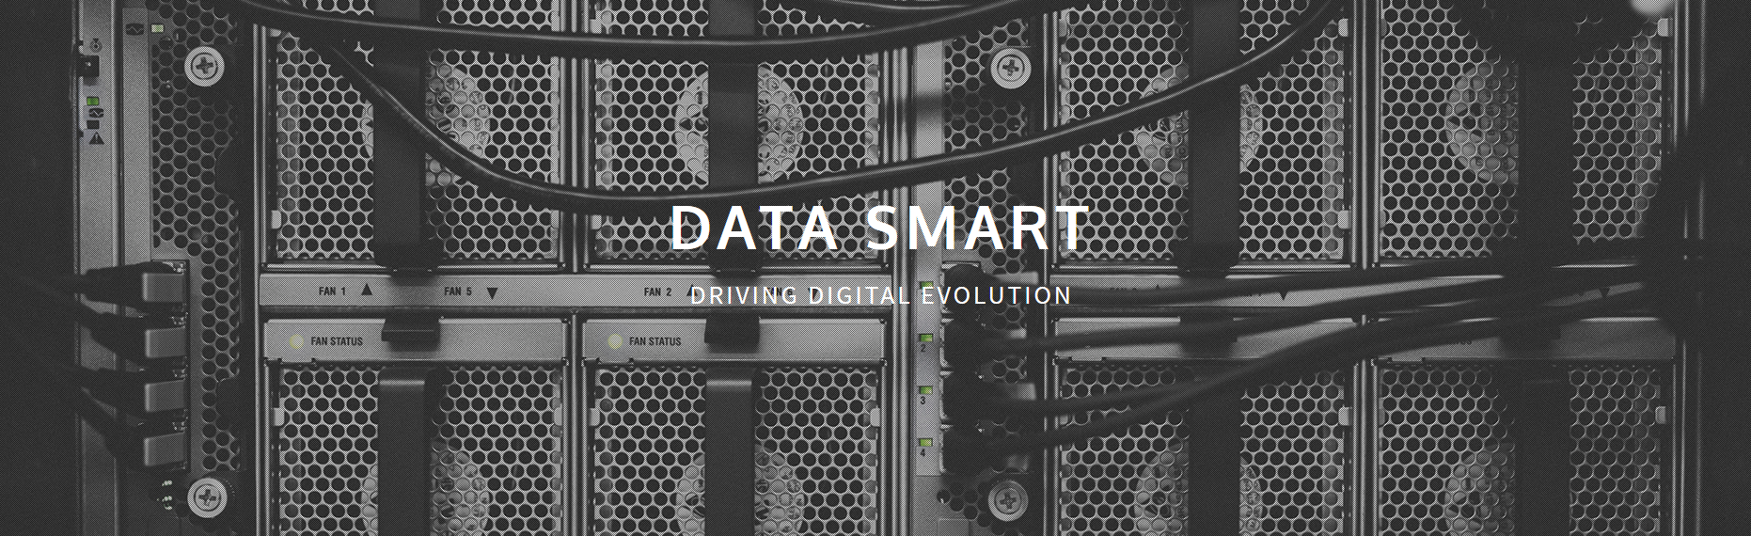
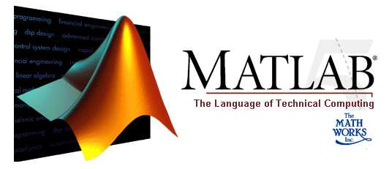

Soft skills are in demand

Slide 11
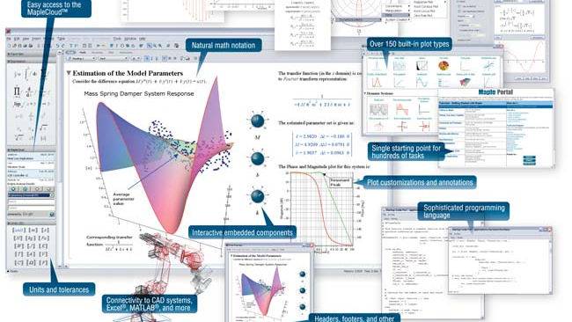
The Maple Environment

Slide 12
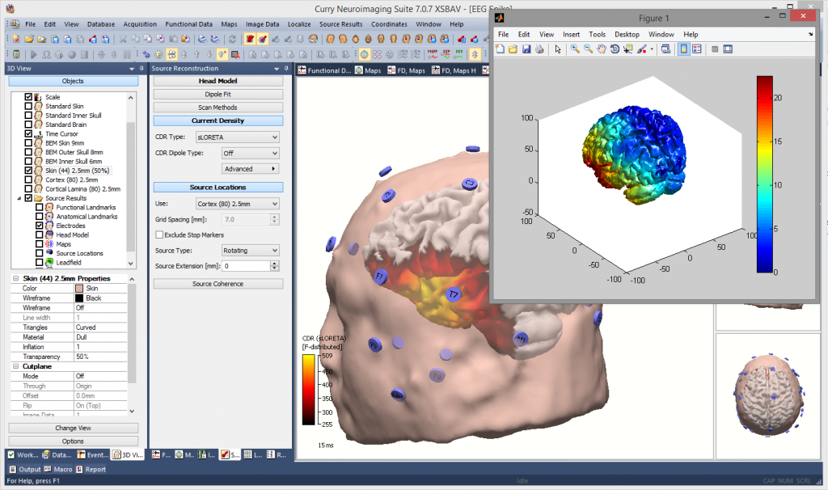
MATLAB & Mathworks

Slide 13
Course Mission
Data curation
problems
Introduce students into the mathematical foundations of modern Data Science.
01
Why the standard statistical methods often do not work for the highly correlated, multivariate, and heterogeneous data arrays?
02
What is the best data aggregation strategy? When is the data set for a given problem complete? For how long should we keep the collected terabits of data?
03
MAPLE + MATLAB platforms.
04

Slide 14
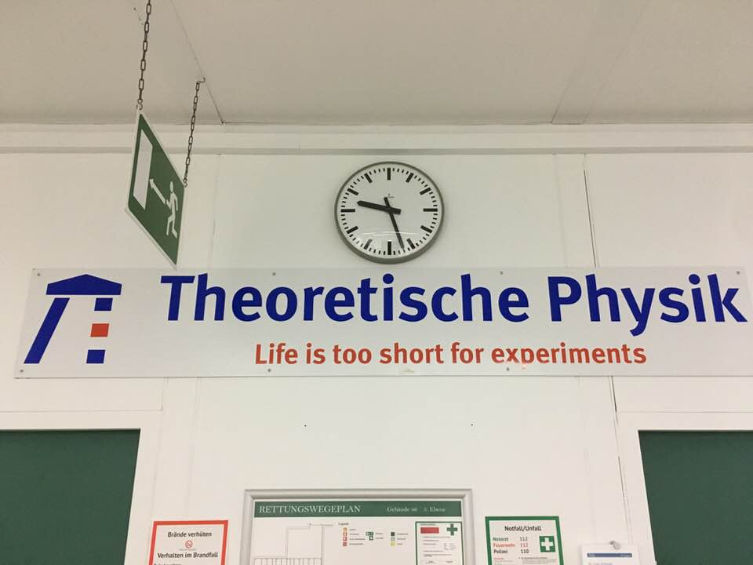
Why have the new methods of data analysis been developed only recently?
(The earliest approaches are dated back to the WWII)
A culture of Thought Experiments…

Slide 15
Cultural Mission
“Science is the legitimate and beloved daughter of the Church and she must have confidence in the Church” © Cardinal Barberini
(Materials of the Galileo Process GBA 5: 146).
Model, hypothesis,
or a prejudice
Selected data supporting the prejudice
Science
Always a social construct
Forgery & falsification to meet socially acceptable expectations
“CDC (Centers for Disease Control and Prevention) bases its recommendations on science in consideration with community standards and wishes”
“science-based.”

Slide 16
Cultural Mission
“Science is the legitimate and beloved daughter of the Church and she must have confidence in the Church” © Cardinal Barberini
(Materials of the Galileo Process GBA 5: 146).
Model, hypothesis,
or a prejudice
Selected data supporting the prejudice
They say that models are necessary to “understand” the data
Science
Always a social construct
Forgery & falsification to meet socially acceptable expectations
Automated interpretation 1 (dramatic reduction of degrees of freedom)
Automated interpretation 2 (dramatic reduction of degrees of freedom)
“Post-Science”
Data 1
Data2
Data 3
A human is not involved in the interpretation process

Slide 17
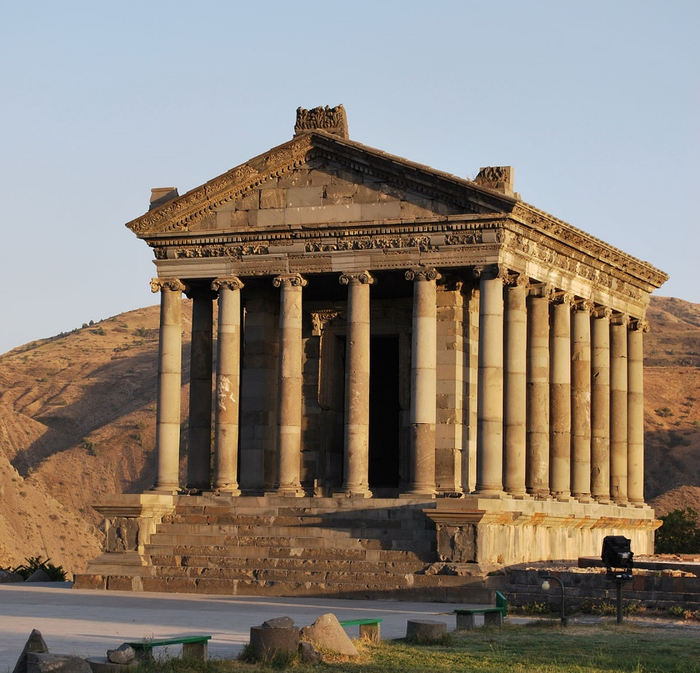

Data literacy already in schools
Science: A few individuals chosen selectively, trained intensively, and paid highly to fit the data to a socially acceptable model
Post-science: Everybody should be able to process the necessary data with their iPhones…
Do not make decisions relaying upon the ”expertise” of anybody else…
“Priests of science”

Slide 18
Learning outcomes
Students will be able to discern between the true and fake data services that often amass a great online reputation virtually for nothing in today's digital world.
01
Students will get a work experience within the symbolic and numeric computing environments, such as MATLAB and MAPLE.
02
Students will learn about geometric properties of high-dimensional space, best-fit subspaces and Singular Value Decomposition, Graph Theory, Markov Chains, Machine Learning, Clustering Algorithms, etc.
03

Slide 19
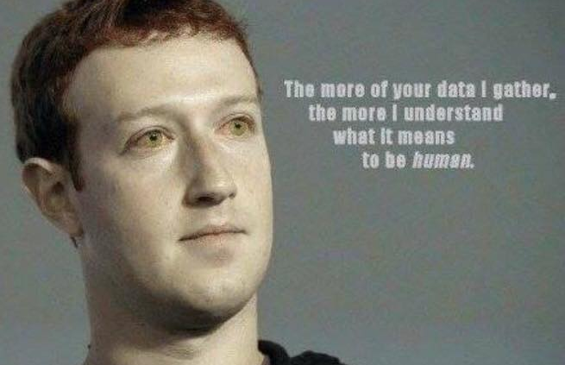
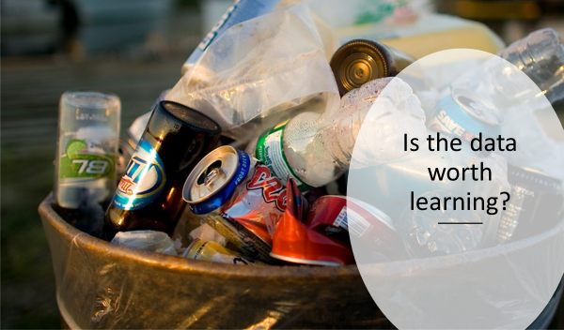

Slide 20
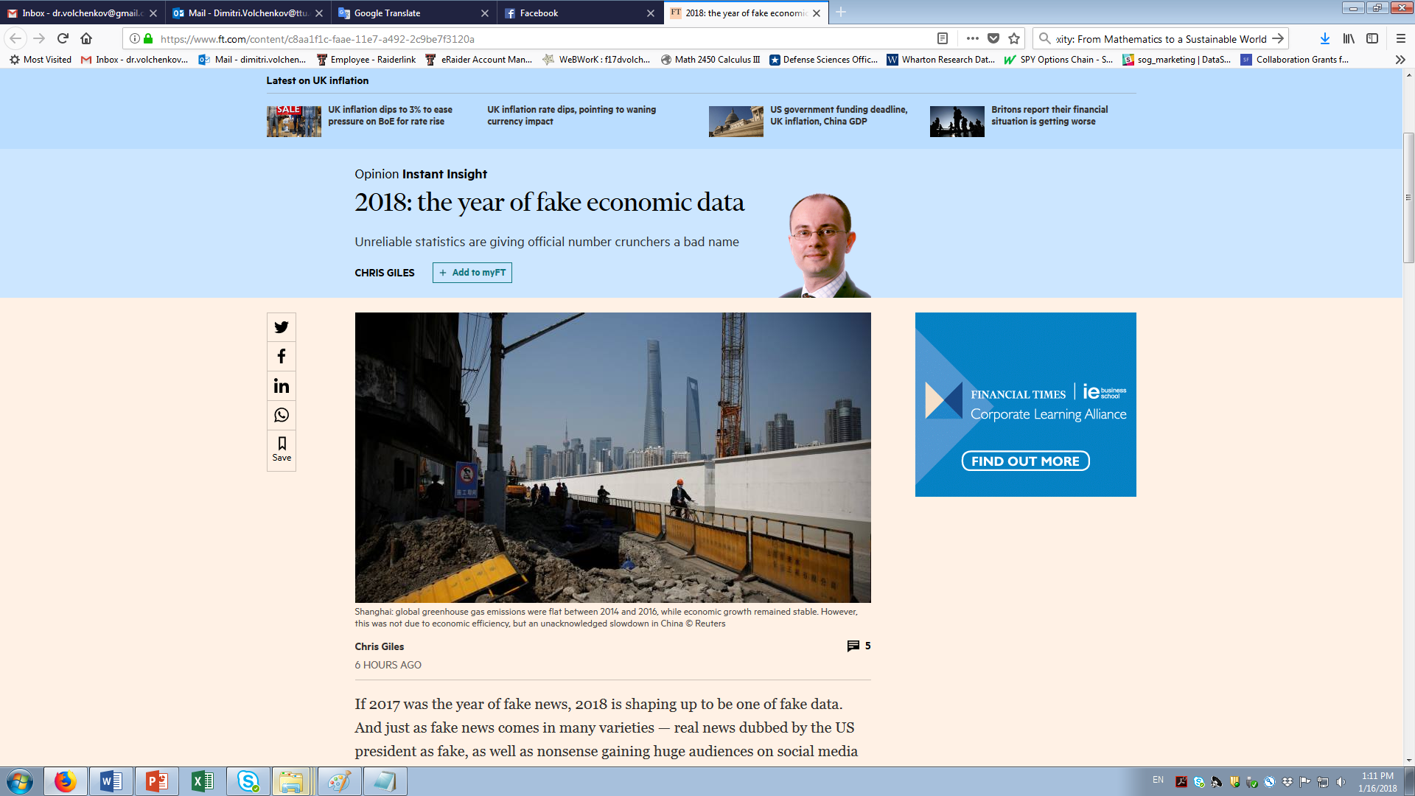
Fake News? Fake data!
“Producing fake data, it appears, is condoned at official levels. Publishing real data lands you up in court. Much more of this and the public will be right to lose trust in official statistics.”

Slide 21
Slides are sent out immediately after/before the lecture to all registered emails;
Books (and links) are sent out immediately after/before the lecture to all registered emails;
Announces of course related seminars & news are sent out immediately after/before the lecture to all registered emails;
Slides might contain homework (the elementary problems (Maple/Matlab), or proofs) expected to be reported back to me;
Please, actively use all web recourses available!
https://www.maplesoft.com/applications/category.aspx?cid=215&oldversions=true https://www.mathworks.com/solutions/machine-learning.html
Watch videos;
Ask questions!!!
We have to learn from each other!

Slide 22
Grading Policy
Activity | worthiness
Attendance | 10%
Homework (?) | 20%
Individual / group projects | 70++%

Slide 23
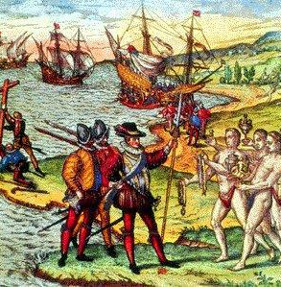
Individual / group projects
Possible projects:
https://www.analyticsvidhya.com/blog/2016/10/17-ultimate-data-science-projects-to-boost-your-knowledge-and-skills/
https://www.dataquest.io/blog/free-datasets-for-projects/
Search yourself (among what interests you most of all!) – any topic is welcome!

Slide 24
Please, propose YOUR OWN PROJECTS for your own datasets!
Please, discuss your project with me as soon as possible;
Please, after discussing, write and send me a brief (of one-page) project proposal, explaining
-- the goals and objectives of your study,
-- the data source and volume,
-- the data processing methods and algorithms, and
-- the expected outcomes of the project.
At the end of the course, make a presentation about your project in class.
HW 1

Slide 25
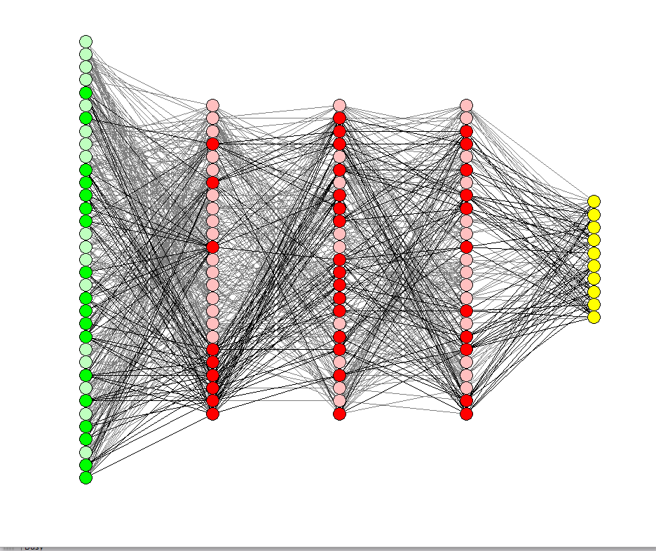

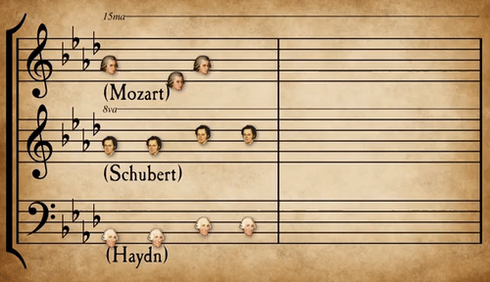

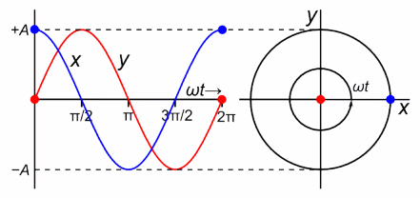

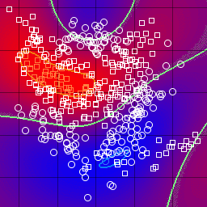
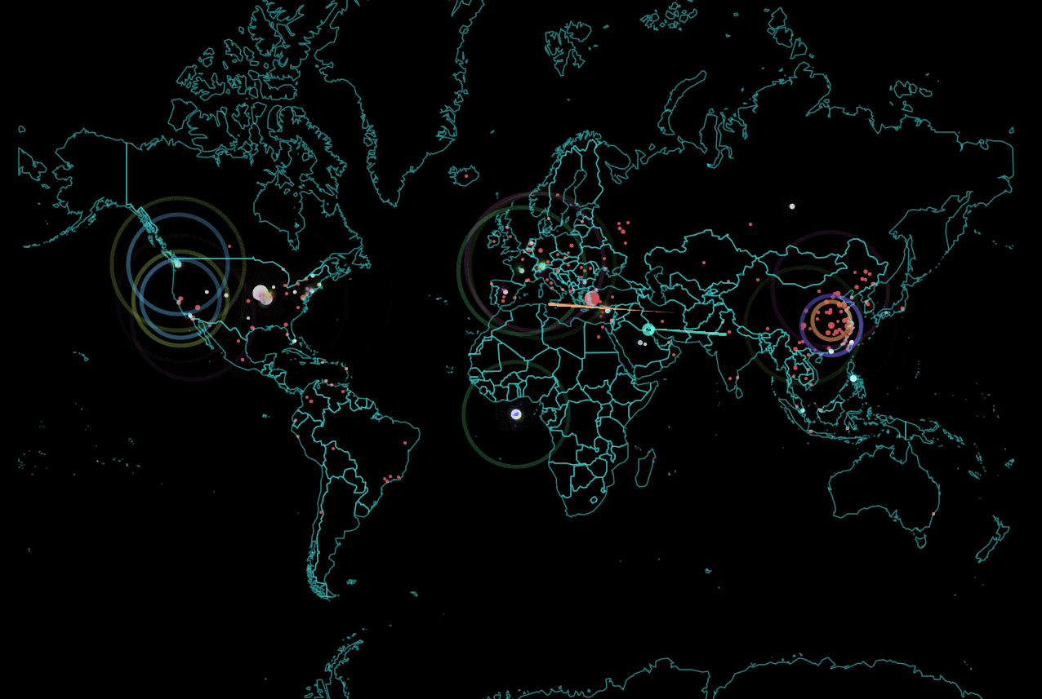
46 hours –
your presentations ☹

